Slide 1
Electronics Practical
S.Y.B.Sc. (C.S.)Sem IV
Group A
Sharmishtha B Sumbe
Nowrosjee Wadia college

Slide 2
Interfacing of LED to Raspberry Pi

Slide 3
Aim:
To interface LED with Raspberry Pi and blink the LED with 500 milli second delay.
Apparatus:
Raspberry Pi 3 model B+
5 mm LED-1
330Ω resistor-1
Bread board
Connecting wires
Others (computer, Ethernet cable, power supply for Raspberry Pi etc.)

Slide 4
Theory
A simple LED circuit consists of a LED and resistor. A resistor is used to limit the current that is being drawn and is called a current limiting resistor. Without the resistor the LED would run at too high of a voltage, resulting in to much current being drawn which in turn would instantly burn the LED and likely also the GPIO port.
Procedure
Connect LED’s anode end is to GPIO pin (here Pin no. 17) of GPIO header through 330 Ω resistor and cathode end to GND pin (here Pin no. 6) of GPIO header. Write the program to blink LED

Slide 5
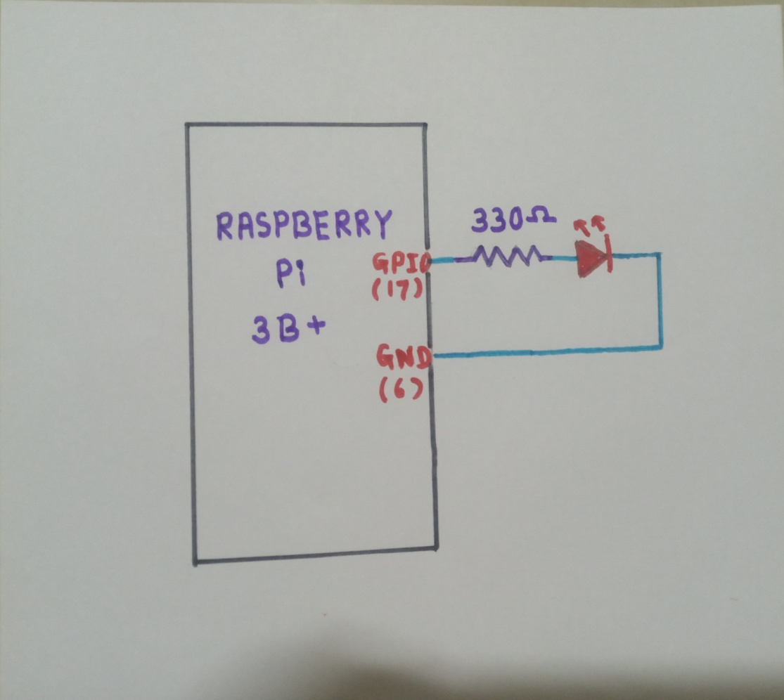
Circuit diagram

Slide 6
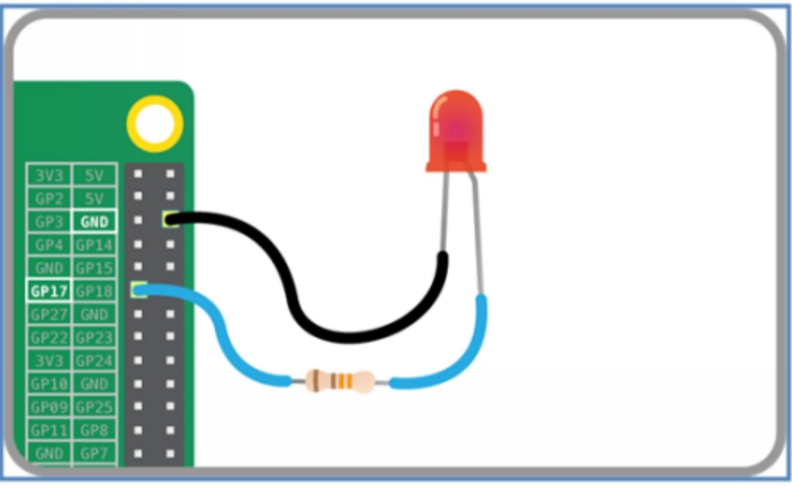
Connections

Slide 7
Program
#PROGRAM TO BLINK LED
Import RPi.GPIO as GPIO #import Raspberry Pi GPIO library
Import time # import time module
GPIO.setmode(GPIO.BCM)# use GPIO numbering. We can use physical numbering using .BOARD
GPIO.setup(17,GPIO.OUT) # set GPIO pin 17 as output pin
while True: # run forever
GPIO.output(17,GPIO. HIGH) # Turn ON LED
time.sleep(.5) # sleep for 500 ms, it’s a delay
GPIO.output(17,GPIO. LOW) # Turn OFF LED
time.sleep(.5) # sleep for 500 ms, it’s a delay

Slide 8
Execution of program
Save program with .py extension
e.g. blinking_led.py
Name will be displayed as $ python blinking_led.py
Program will run continuously as is in infinite loop.
To stop the program click either stop in your IDE(IDLE) or ctr+C if you run it inside console.
Result:
Conclusion:

Slide 9
Assignment
1. Rewrite the program with following modifications.
a. Connect LED to any other GPIO pin.
b. Use physical numbering
c. Change delay to 1 second
2. Write the program to blink two LED’s (LED1 and LED2) connected to, two different GPIO pins. It should satisfy following conditions
a. When LED1=ON, LED2=OFF
and when LED1=OFF ,LED2=ON.
b. Delay=200ms.
c. Use GPIO numbering

